Slide 1

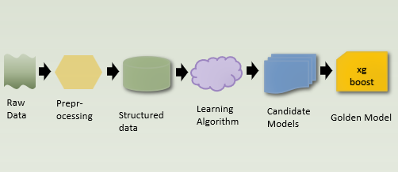
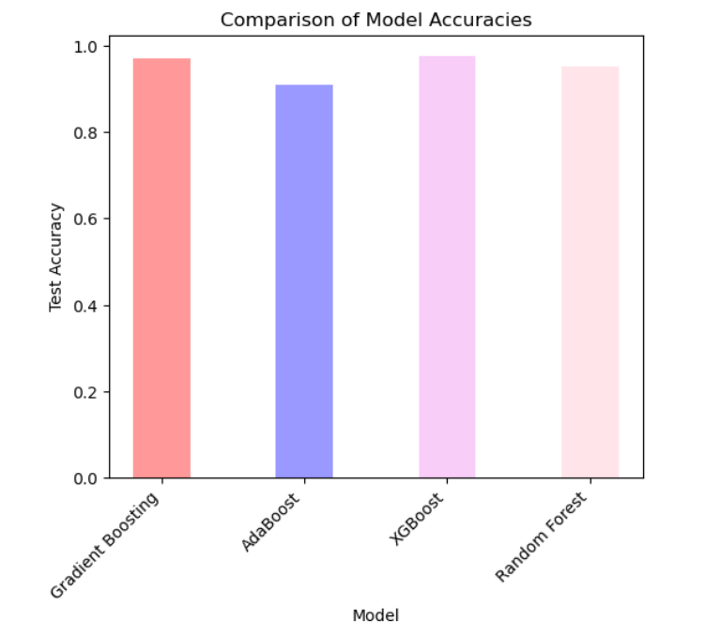
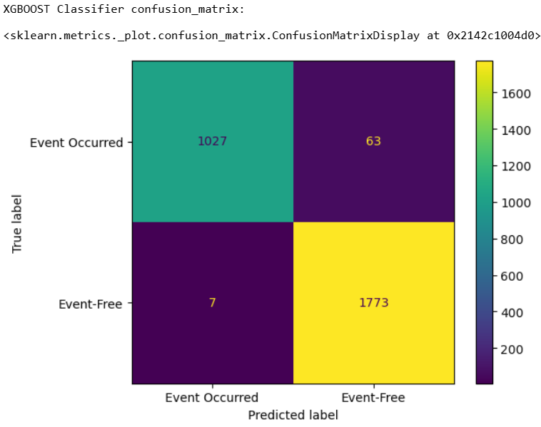
PREDICTING SURVIVAL RATE FOR HEMATOPOIETIC STEM CELL
TRANSPLANTATION USING MACHINE LEARNING
Sajan Kumar Thallapelly [sthallapelly@atu.edu], Dr. Robin Ghosh [rghosh@atu.edu]
Department of Engineering and Computing Sciences, Arkansas Tech University, Russellville, Arkansas 72801
INTRODUCTION
DISCUSSION
Hematopoietic Stem Cell Transplantation (HSCT) is a crucial treatment for hematologic malignancies and immune disorders. This study applies machine learning techniques to classify event-free survival.
METHODOLOGY
The objective of this research is to enhance survival prediction accuracy post-HSCT using machine learning models. The study aims to develop a reliable predictive model that can assist healthcare professionals in decision-making and improving patient outcomes.
RESEARCH PURPOSE
* These confusion matrices compare the classification performance of three models, XGBoost, Gradient Boosting, and Random Forest, in predicting two classes (Event Occurred and Event-Free).
FINDINGS AND RESULTS
The graphs illustrate the accuracy rates of four machine learning models - Gradient Boosting, AdaBoost, XGBoost, and Random Forest - in predicting HSCT survival. Our research on HSCT Survival Prediction evaluated four machine learning models, with XGBoost achieving the highest test accuracy score of 0.976, followed by Gradient Boosting at 0.971, Random Forest at 0.954, and AdaBoost at 0.911.
DATASET INFORMATION
We employed this dataset from a Kaggle Competition, consists of 28,800 patient records with 60 clinical features.
After performing data cleaning, statistical analysis, and visualization, PCA was applied to reduce dimensionality while retaining 95% variance.
The refined dataset was then partitioned for training and validation to ensure robust model evaluation.
CONCLUSION
The findings suggest that XGBoost is the best-suited model for HSCT survival prediction, making it a valuable tool for healthcare professionals in assessing patient outcomes.

Slide 2
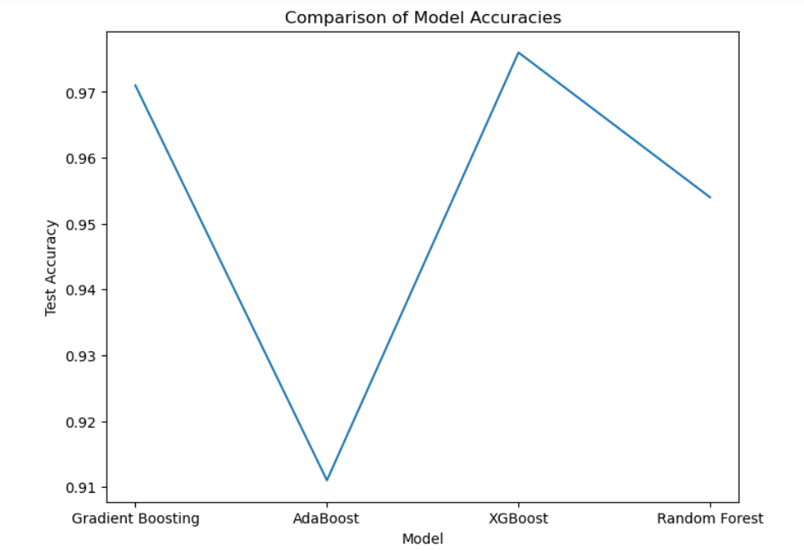

Slide 3
